Slide 1
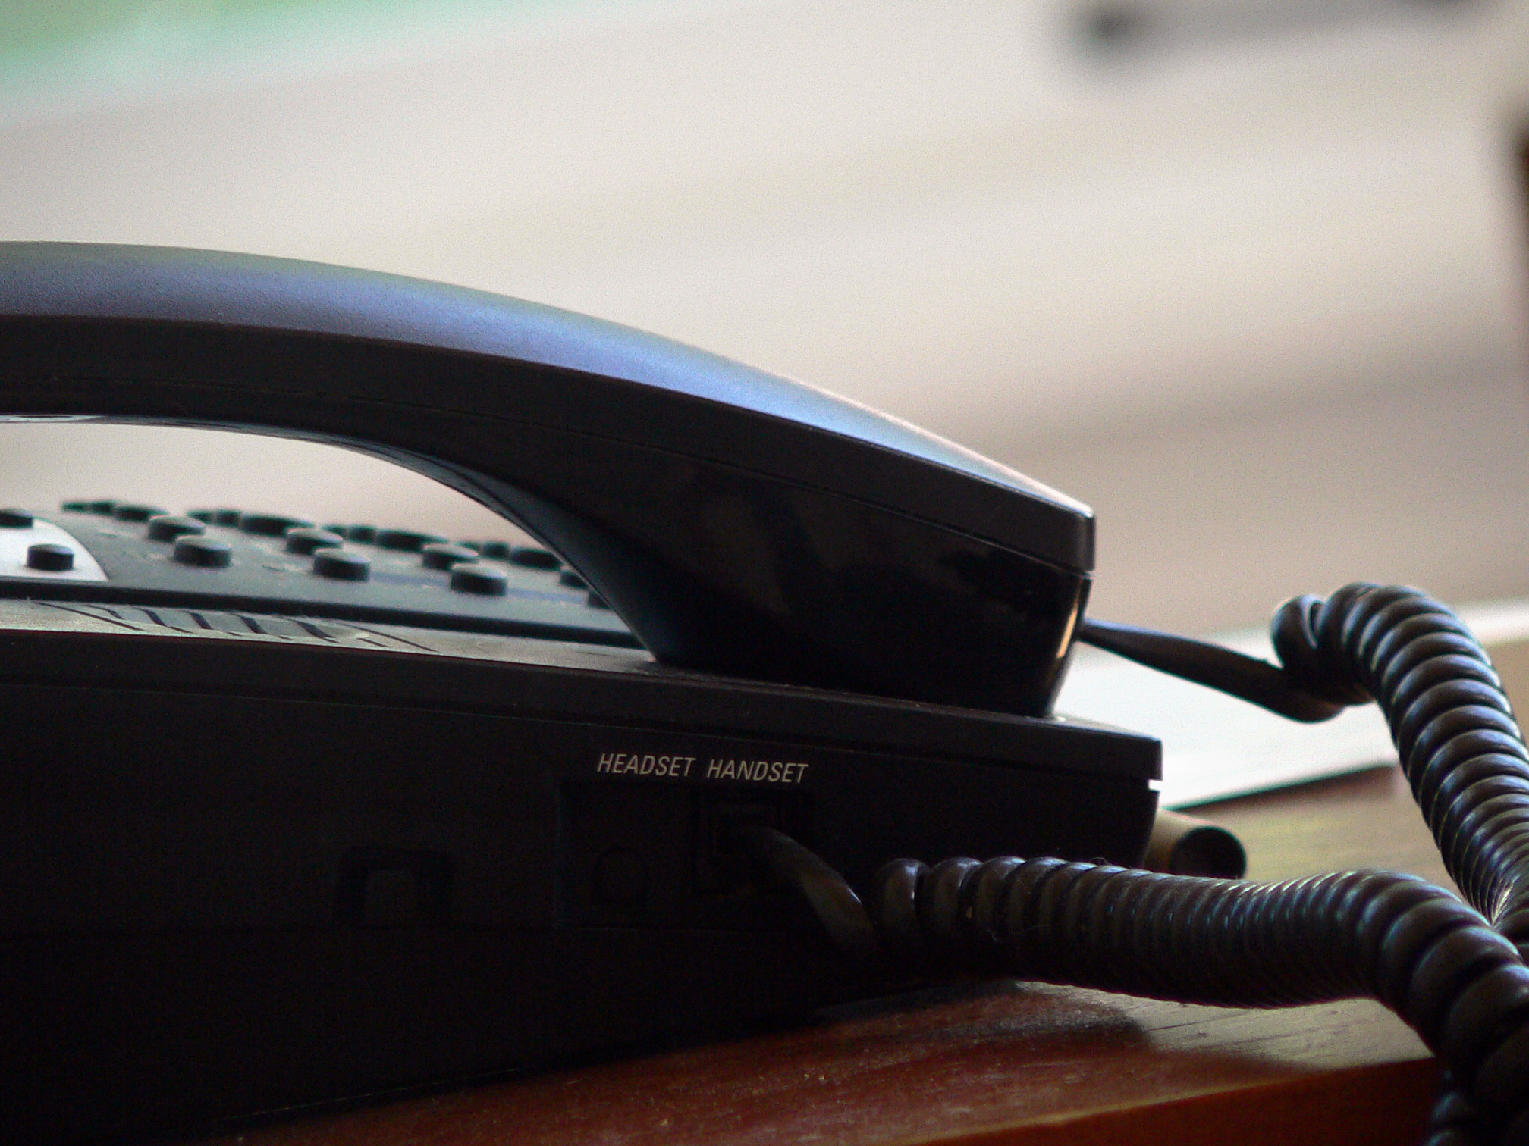
Eileen the Phone Room Queen
Daniel Salem, Tamaron Johnson, Enduo Xu, Andrew Gates, Michael Donohue, Gloria Antonios

Slide 2
I needed help to pay for school uh-huh I needed help to pay for school uh-huh So I called up financial aid And they made sure my bills got paid

Slide 3
Eileen was on the other end uh-huh Eileen was on the other end uh-huh My money issues she could mend She told me how much I could spend

Slide 4
Humble nice and friendly is Eileen Humble nice and friendly is Eileen Although in person she's not seen Her title is the phone room queen

Slide 5
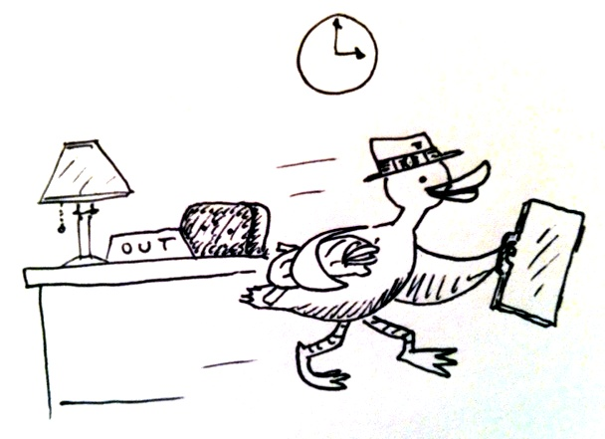
She comes in for 8 hours a day She comes in for 8 hours a day But after that she will not stay it's home to her kids when she goes on her way

Slide 6
Rockville High is where she volunteers Rockville High is where she volunteers Her talents, they are to revere She teaches students how to cheer

Slide 7
GIVE IT UP FOR EILEEN

Slide 8
A tender caring mother is Eileen A tender caring mother is Eileen She has two daughters by her side She raised them to grow up with pride

Slide 9
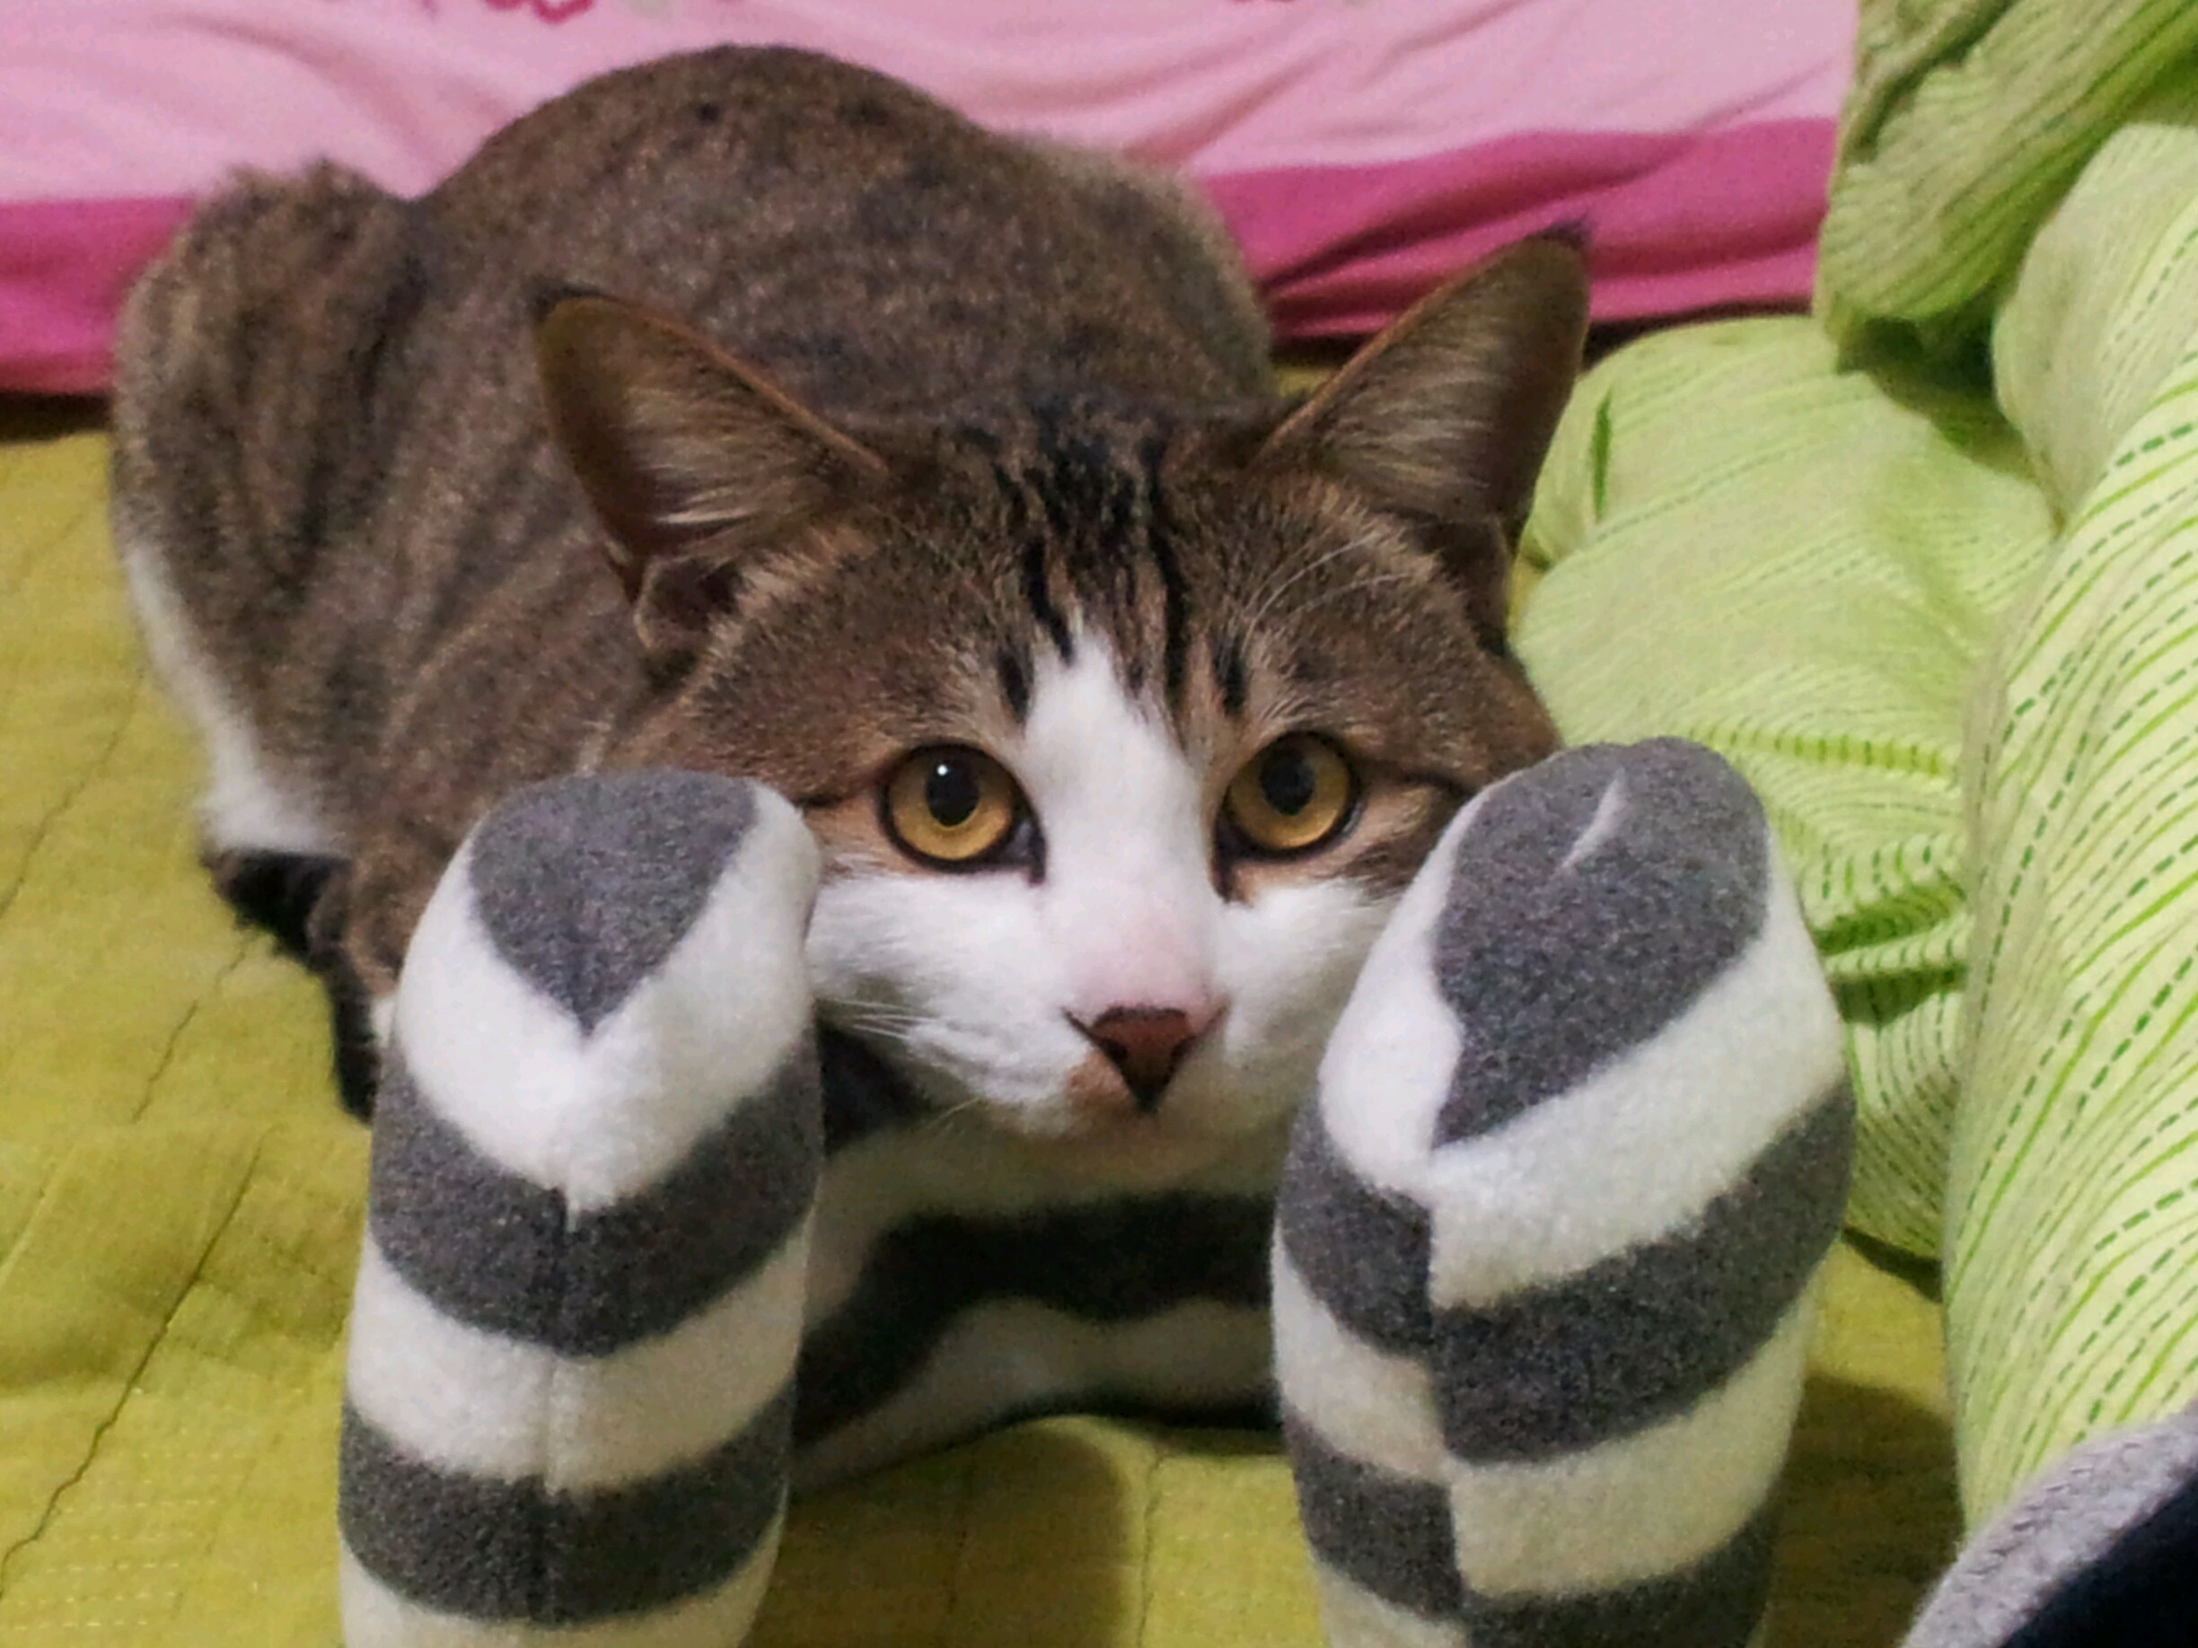
Her favorite pets to have at home are kittens Her favorite pets to have at home are kittens The one at home, it goes by Mittens She guarantees that you'll be smitten.

Slide 10
She’ll testify she loves her job uh-huh She’ll testify she loves her job uh-huh A lousy day is very rare And it don’t hurt that there’s healthcare

Slide 11
She’s been working here for 25 years uh-huh She’s been working here for 25 years uh-huh Shes never left a kid in tears, She'll quell all your money fears

Slide 12
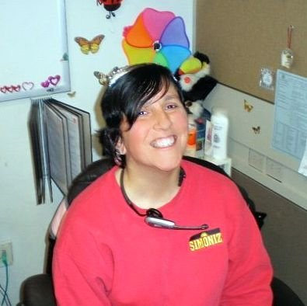
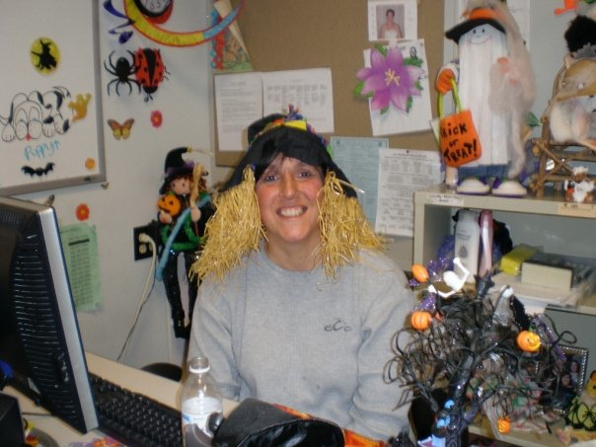
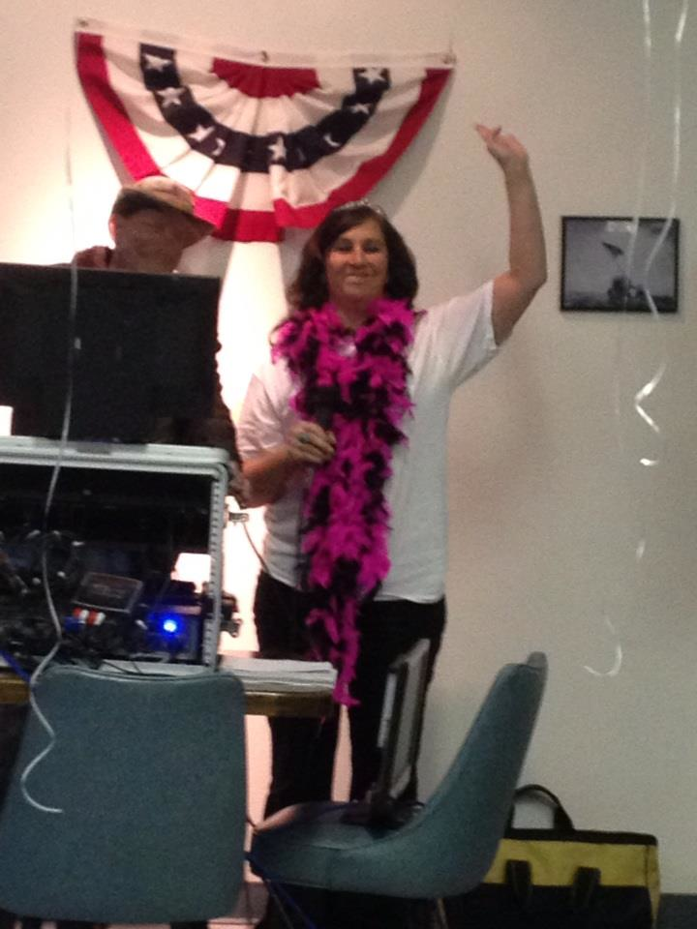
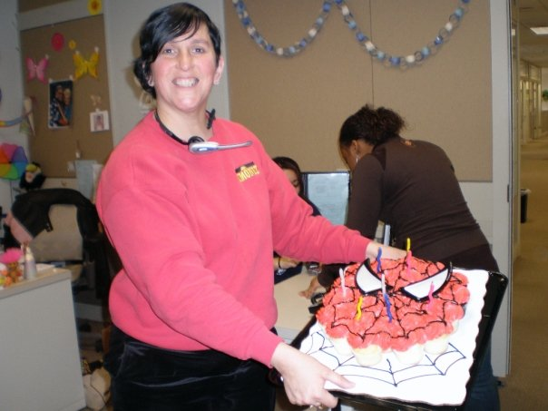
THANK YOU EILEEN FOR ALL OF YOUR HARDWORK & DEDICATION TO UCONN.

Slide 13
Photo Bibliography: https://d3n8a8pro7vhmx.cloudfront.net/statecorruption/pages/210/attachments/original/1335621441/office_phone2.jpg?1335621441 http://www.dolmanbateman.com.au/wp-content/uploads/2012/01/bankruptcy.jpg http://i.imgur.com/OgSm5.jpg http://marielamba.files.wordpress.com/2013/01/mp900426527.jpg http://1.bp.blogspot.com/-t0gDpr0d1lI/TV2_xOCWBKI/AAAAAAAAADQ/O7yEF51TJAQ/s1600/leaving_work_early.JPG http://www.fitforlife.com/MPj04277860000%5B1%5D.jpg http://www.newsletternewsletter.com/Months/May02/banqt3.jpg http://cf.ltkcdn.net/cheerleading/images/std/50885-283x424-AnimatedCheerleadingClipart.jpg

